Slide 1
Prediction Of Taxi Trips Duration in New York City Using CRISP-DM Methodology
By
Mayank Gandhi
10394669
&
Mazin Ahmed
10394393

Slide 2
OUTLINE
Business Understanding
Data Understanding
Data Understanding & Preparation
Modeling
Evaluation & Deployment
Conclusion

Slide 3
Business Understanding
Why predicting journey duration ?
To identify which driver should be assigned to each pickup request.
How predicting journey duration going to help NYC taxi ?
It will directly improve the efficiency of electronic taxi dispatching systems.

Slide 4
Business Understanding
Who are my Stakeholders ?
Customer Base.
Government.
Employees.

Slide 5
Business Understanding
Potential Analytics Solution:
Prediction of Taxi Trip Duration of taxi rides in New York to improve the efficiency of Electronic Taxi Dispatching Systems which will decrease time loss and increase the profits.
Refined Problem Statement:
To predict the duration of taxi rides in New York City based on features like trip coordinates or pickup date and time.
Benefits:
Once we predict the duration of taxi trips, we can use the results to dispatch vacancies of the taxis. This will help us to reduce waiting time of a customer for a taxi ride and which in turn will increase profits for taxi company.

Slide 6
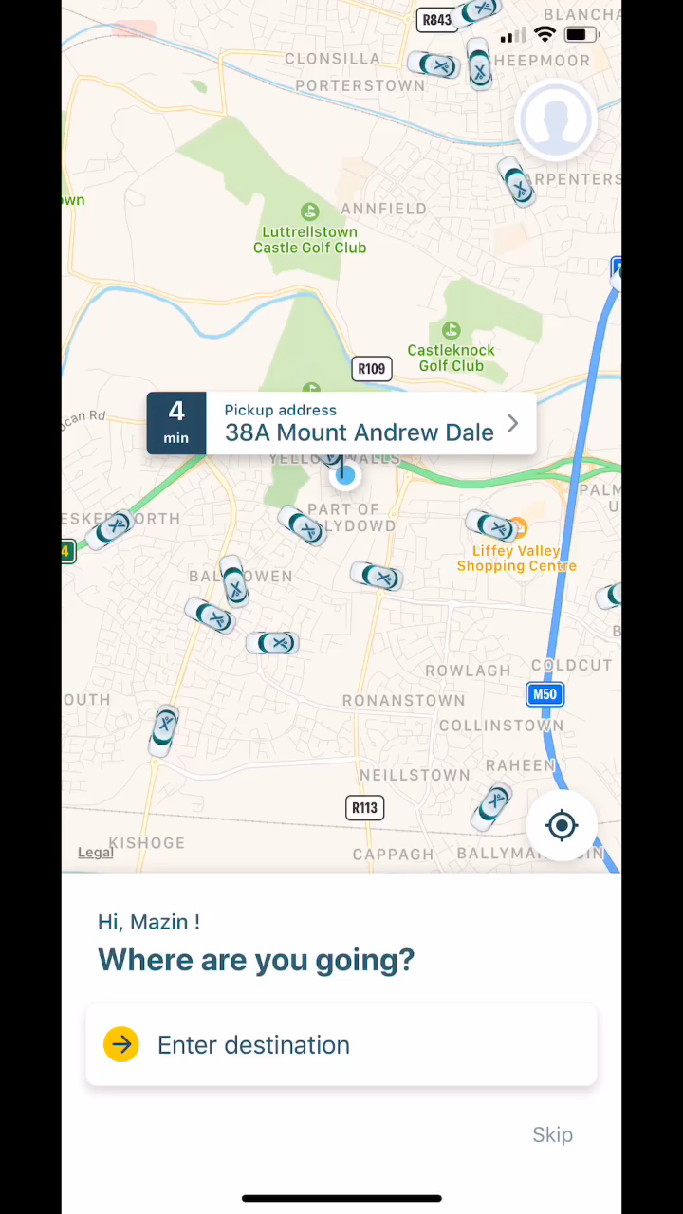
Business Understanding
An Example showing taxi order for Later trips using Mytaxi Mobile application

Slide 7

Data Understanding
The dataset is taken from Kaggle’s “NEW YORK CITY TAXI TRIP DURATION” Competition.
The dataset comes in the shape of 1.4 million observations and 11 features. Each row contains information of one taxi trip.

Slide 8
Data Understanding
The dataset has 11 variables, out of which “trip_duration” is the independent/target variable.
id - a unique identifier for each trip
vendor_id - a code indicating the provider associated with the trip record
pickup_datetime - date and time when the meter was engaged
dropoff_datetime - date and time when the meter was disengaged
passenger_count - the number of passengers in the vehicle (driver entered value)
pickup_longitude - the longitude where the meter was engaged
pickup_latitude - the latitude where the meter was engaged
dropoff_longitude - the longitude where the meter was disengaged
dropoff_latitude - the latitude where the meter was disengaged
store_and_fwd_flag - This flag indicates whether the trip record was held in vehicle memory before sending to the vendor because the vehicle did not have a connection to the server - Y=store and forward; N=not a store and forward trip
trip_duration - duration of the trip in seconds
Data Fields

Slide 9
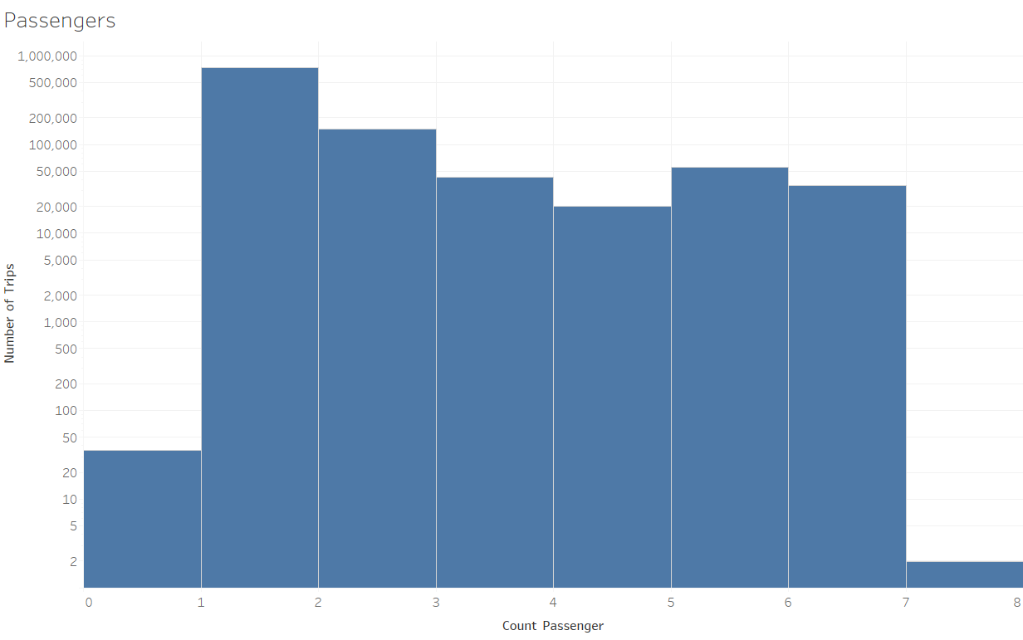
Data Understanding
The Below bar graph shows us the count of passengers on average for taxi trips. Most of the taxi trips has 1-2 passengers. However, we can see that there are very less trips with more than 6 passengers. Passengers count is important for us as it affects the price of taxi trip and taxi trip duration.
Explanatory Data Analysis

Slide 10
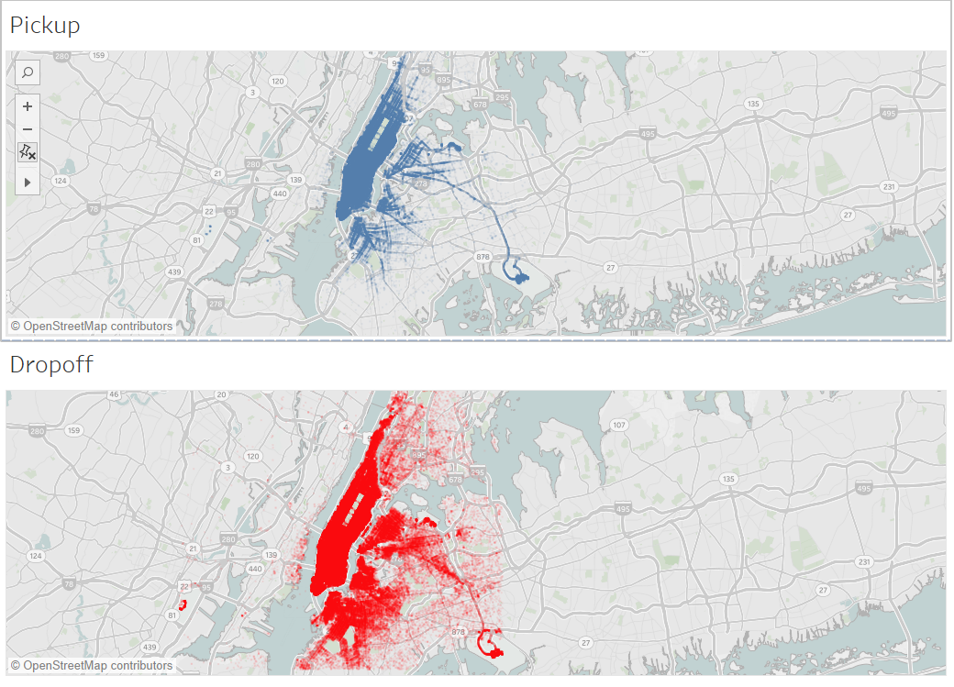
Data Understanding
The map illustrates the pick-up and drop-off locations. We could see how the map varies with the time of the pick up and drop. The map shows us that there are many drop-offs outside of New York.
Explanatory Data Analysis

Slide 11
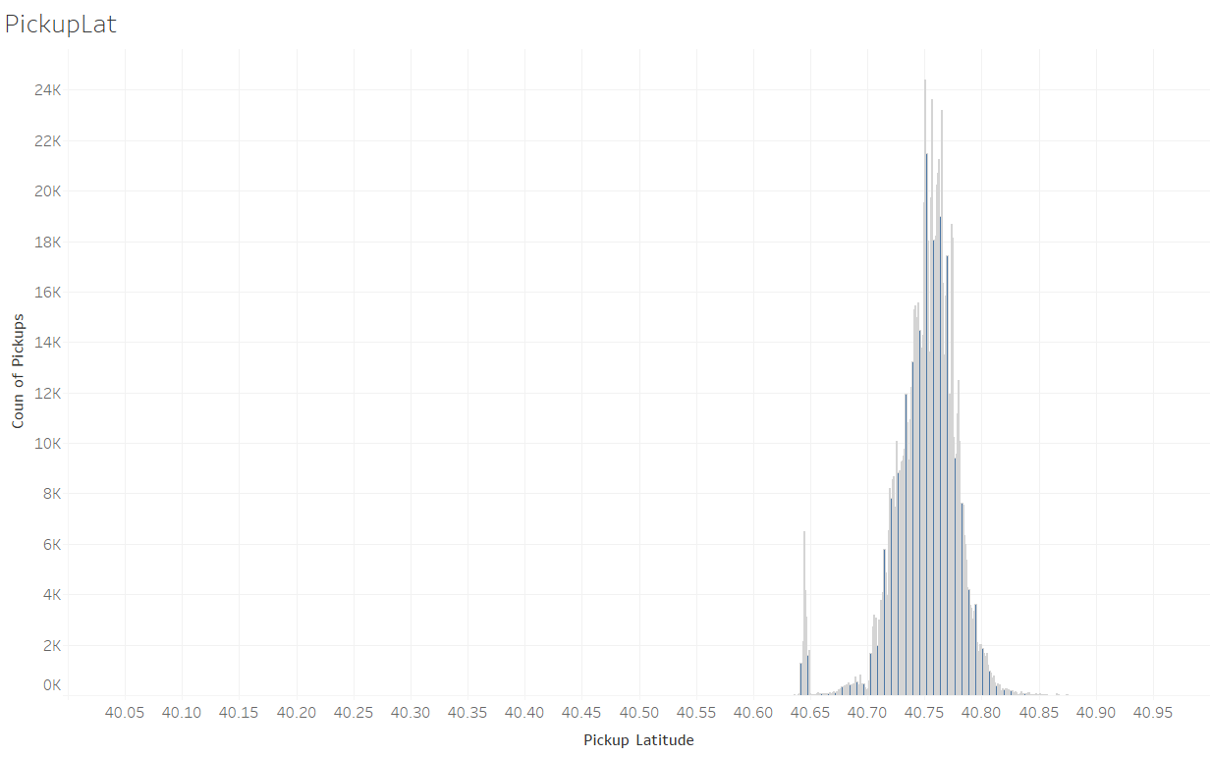
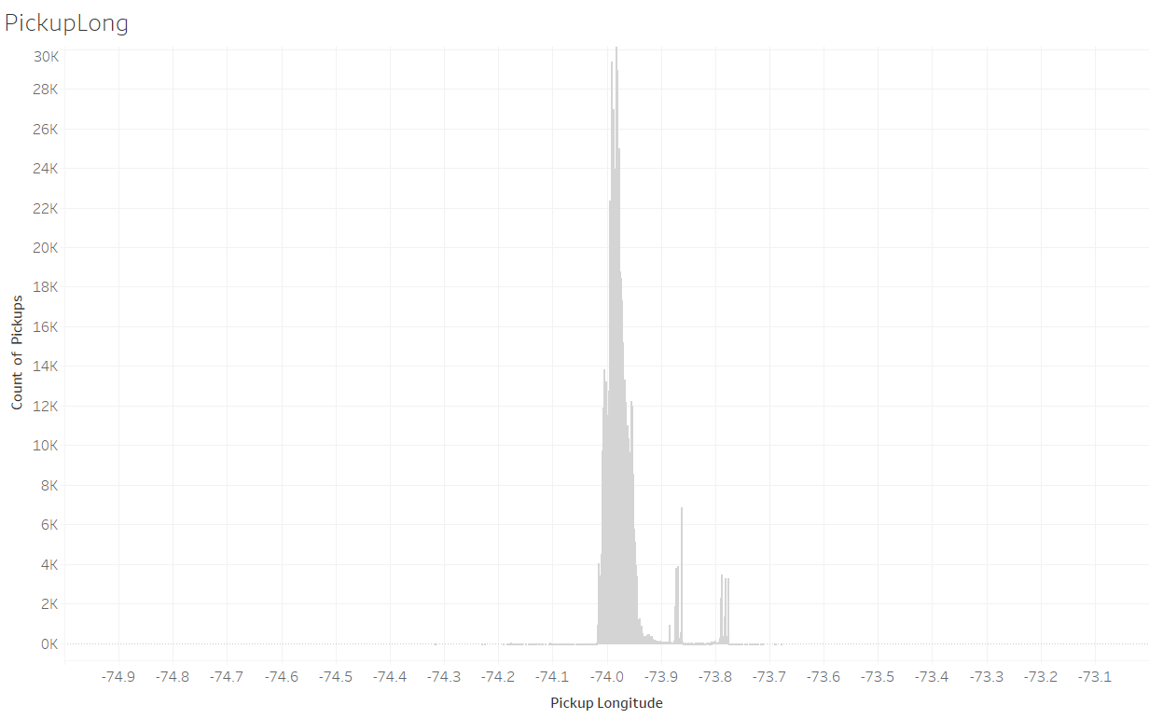
Data Understanding
Explanatory Data Analysis
The below graph represent longitudes of new York. We can eliminate the outlying longitudes as we are considering only taxi trips with new York city.
The below graph represent latitudes of new York. We can eliminate the outlying latitudes as we are considering only taxi trips with new York city.

Slide 12
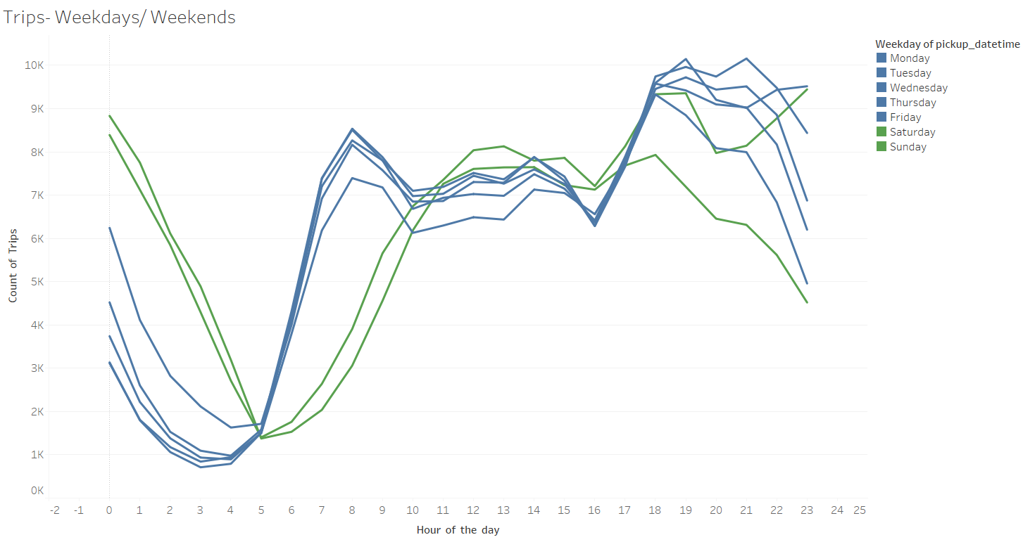
Data Understanding
Explanatory Data Analysis
The line graph shows us that the weekend (Sat and Sun, plus Friday to an extend) have higher trip numbers during the early morning hours but lower ones in the morning between 5 and 10, which can most likely be attributed to the contrast between NYC business days and weekend night life. In addition, trip numbers drop on a Sunday evening/night.

Slide 13
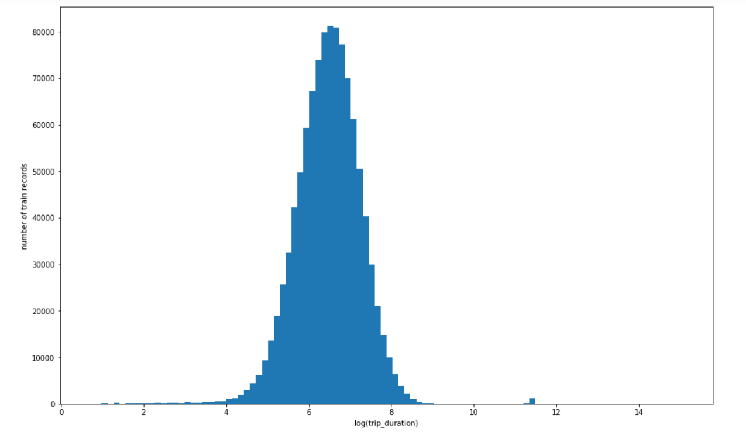
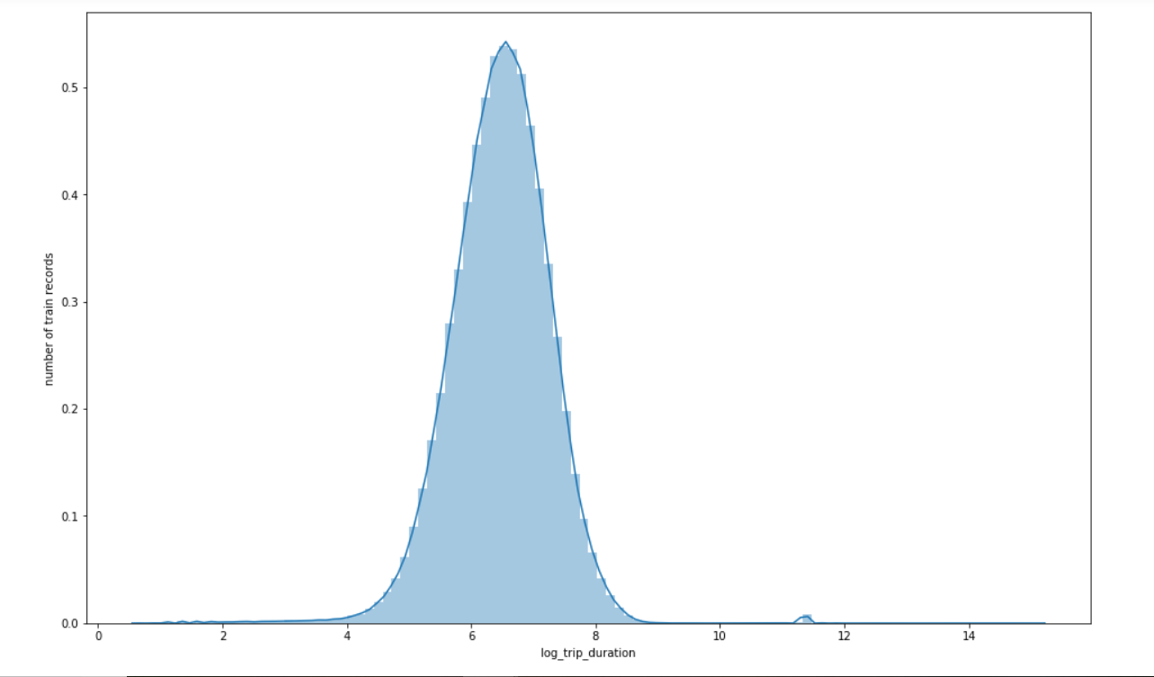
Data Understanding
Explanatory Data Analysis
The average trip duration of taxi trips can help us predicting the taxi trip duration. So, we use numpy’s log feature to regularize our target variable (trip_duration), so that it is easier to visualize. The below graphs illustrate log of trip duration.
.

Slide 14
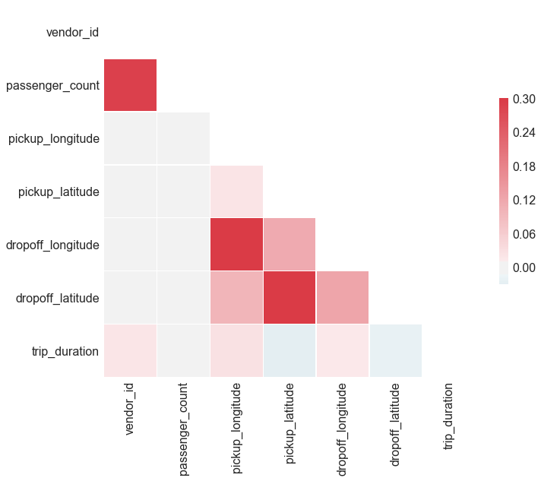
Data Understanding
Correlation Between Features
We don’t have highly correlated variables in our dataset. So we do not have to remove any variables from our dataset.
Explanatory Data Analysis

Slide 15
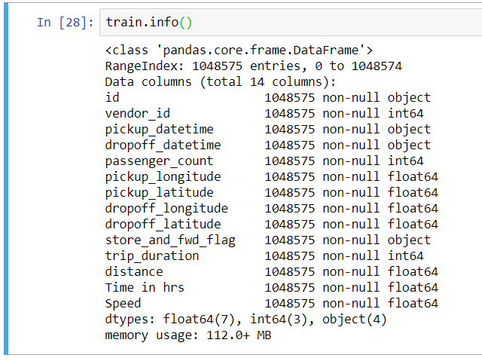
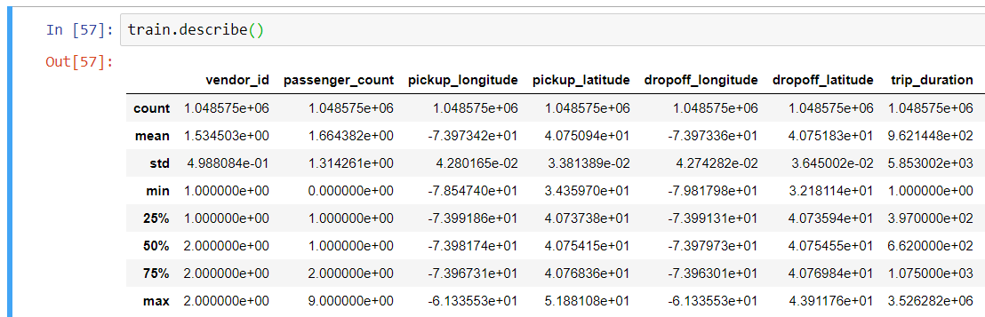
Data preparation
A brief look on the dataset

Slide 16
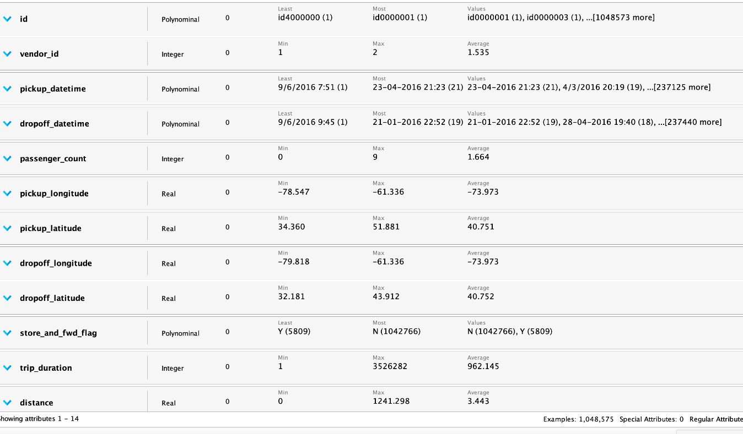
Data preparation
Missing Values
Missing data is the nemesis of every data scientist, especially if they are new in the field. It is important to check whether we have data missing in the train and the test set. There are zero missing data in the dataset.
Data Cleaning

Slide 17
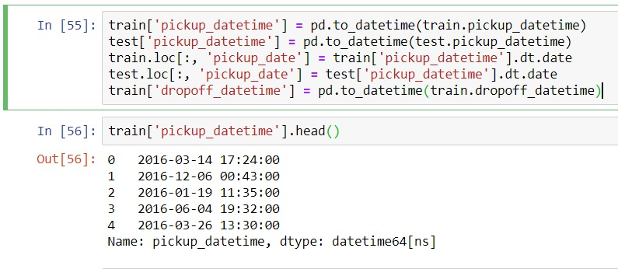
Data preparation
Fixing Date Variables
Pickup and Dropoff date are two of the few variables that are provided. This information could play an important role in predicting the total duration time that is why it needs some attention. I will extract different time features such as hour, week, month and so on.
Data Cleaning

Slide 18
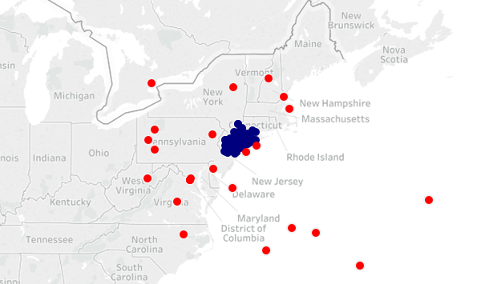
Data preparation
Latitude and Longitude Clean-up
Looking into it, the borders of NY City, in coordinates comes out to be:
city_long_border = (-74.03, -73.75) city_lat_border = (40.63, 40.85)
Comparing this to our `train.describe()` output we see that there are some coordinate points (pick ups/drop offs) that fall outside these borders. So let's limit our area of investigation to within the NY City borders.
Data Cleaning

Slide 19
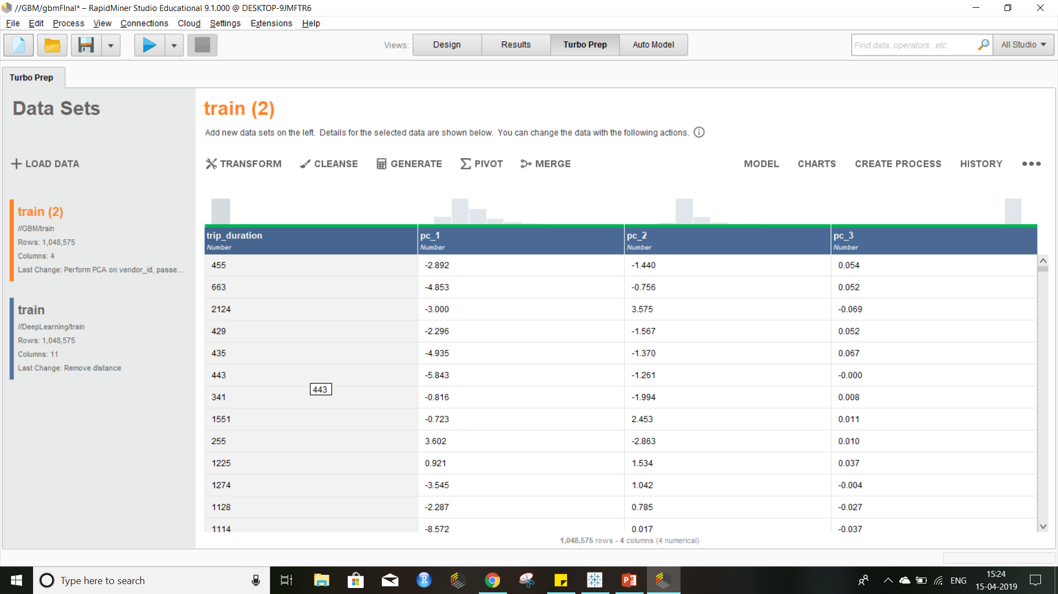
Data preparation
Principal Component Analysis (PCA) is in reality a dimension reduction method. It combines the most important attributes into a fewer number of transformed attributes.
we reduced 10 attributes to only 3 Using RapidMiner PCA
Principal Component Analysis

Slide 20
Modeling
How to choose the model using RapidMiner Auto Model ?
Performance: The less the RMSE the better the model
Run Time : The less the time the better the model

Slide 21
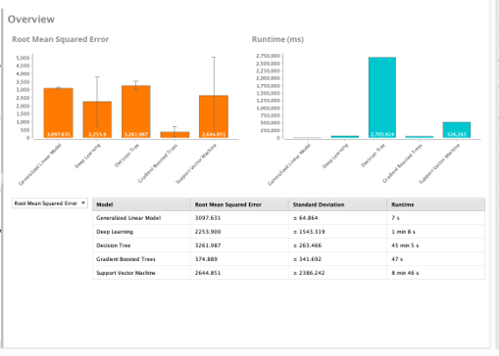
Modeling
We ran our dataset through RapidMainer’s auto model feature.

Slide 22
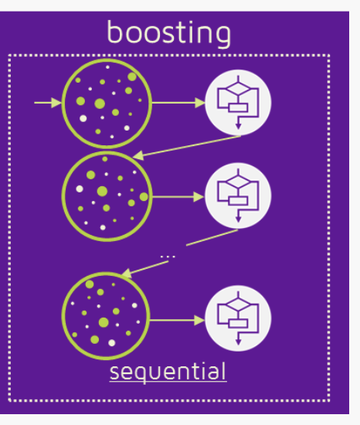
Gradient Boosting Algorithm
Gradient boosting is a machine learning technique for regression and classification problems, which produces a prediction model in the form of an ensemble of weak prediction models, typically decision trees.
The objective of any supervised learning algorithm is to define a loss function and minimize it.

Slide 23
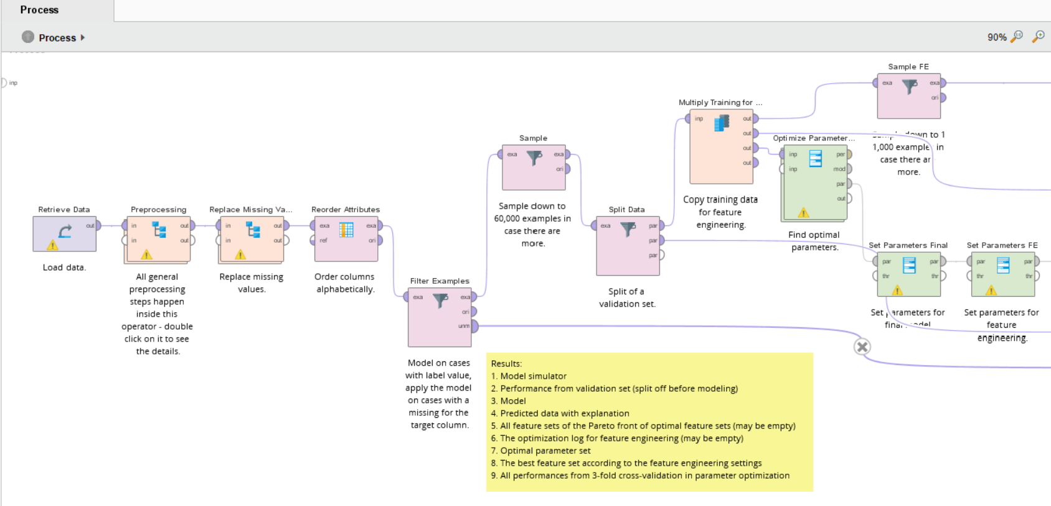
Modeling
Gradient Boosting Process

Slide 24
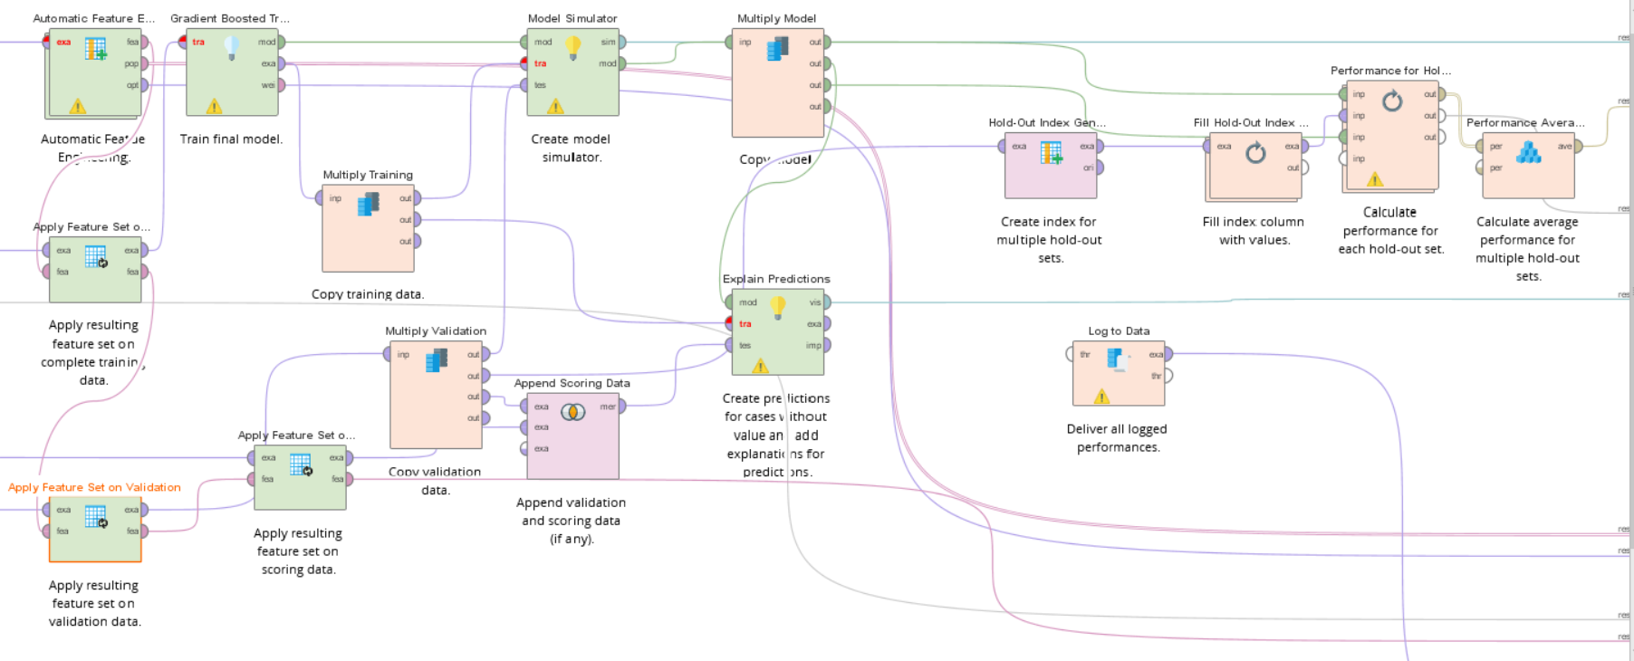
Modeling
Gradient boosting process

Slide 25
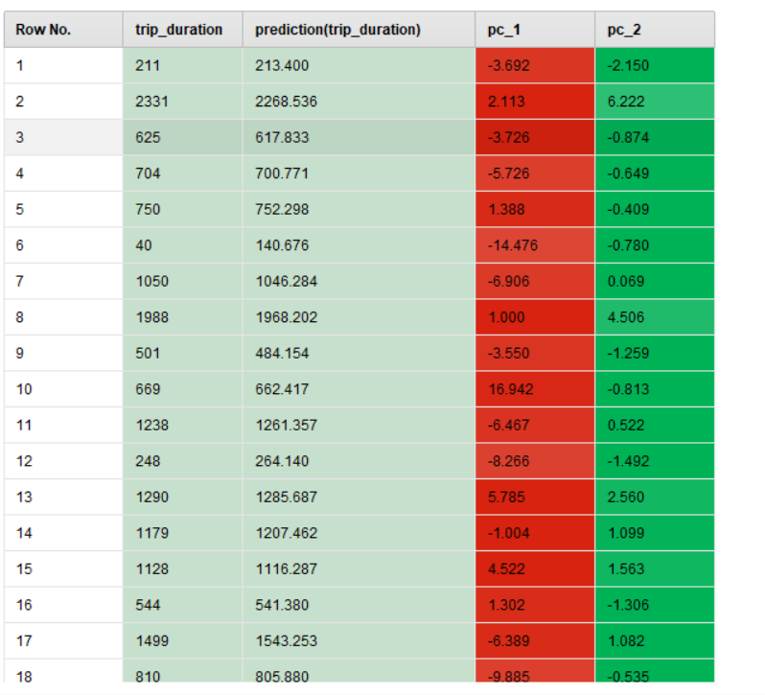
Modeling
GBT model gives out good predictions of taxi trip duration. We can see that our predicted values are almost close to the actual values.
Model Results

Slide 26
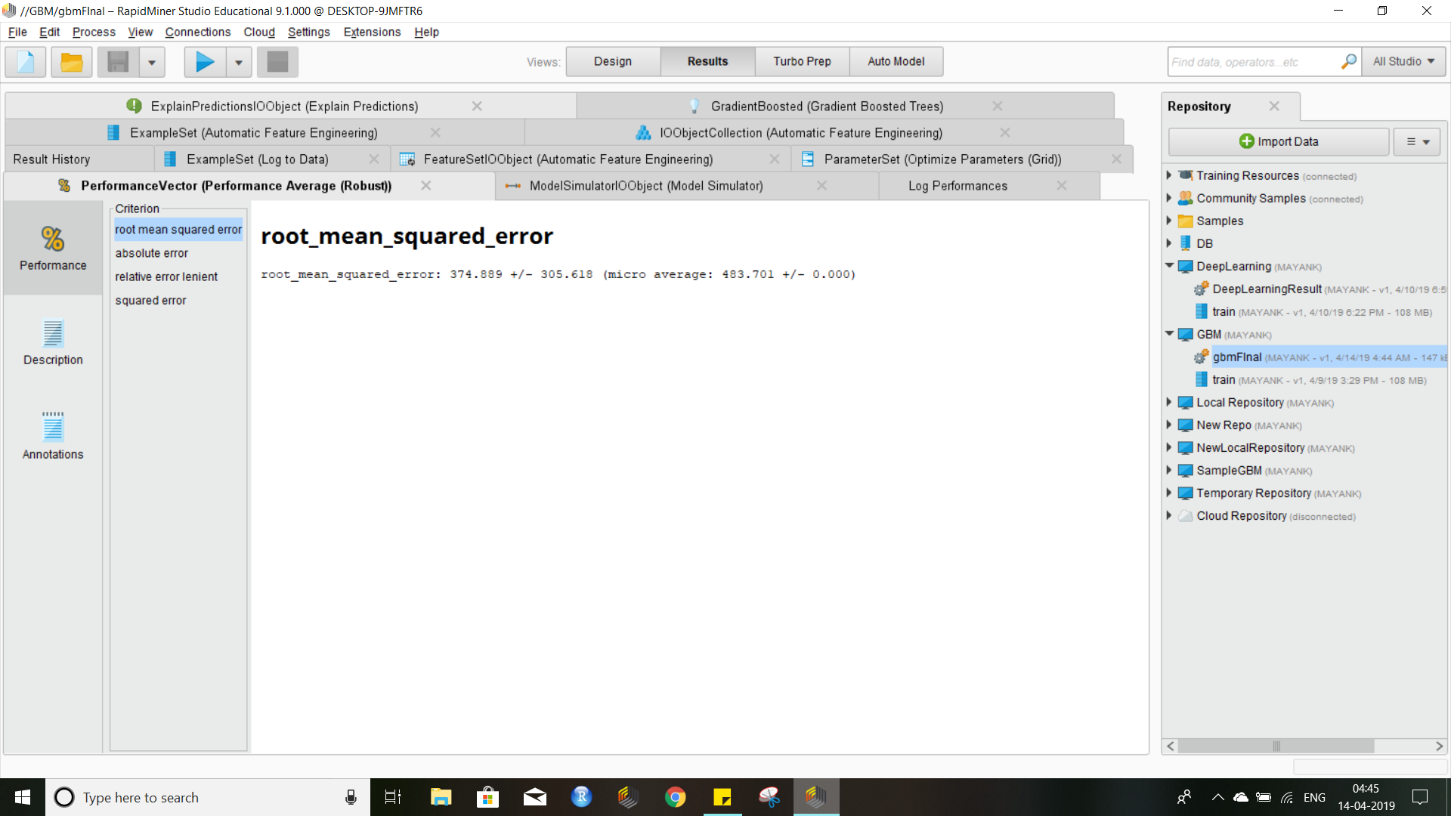
Evaluation
The image below shows us the Performance of our model based on RMSE score. The RMSE score of our Gradient Boosted Model is 374.889.
The evaluation metric which we are going to use for our predictive model is Root Mean Square Error (RMSE) value. RMSE is a quadratic scoring rule that also measures the average magnitude of the error. It’s the square root of the average of squared differences between prediction and actual observation.

Slide 27

Deployment
Our model is converted to PMML standard. PMML stands for "Predictive Model Markup Language".
A PMML file may contain a myriad of data transformations (pre- and post-processing) as well as one or more predictive models.
PMML is a standard for data mining models and is understood by many databases. This way it can be applied on a regular basis on huge amount of data.

Slide 28



Deployment
Applications of the Model
The predictive model built can be used by ride hailing companies such as Uber, myTaxi, Ola, DIDI, etc., for predicting the taxi trip duration and improving the efficiency of Electronic Taxi Dispatching Systems which will decrease time loss and increase the profits.

Slide 29

Conclusion
Using Gradient Boosted Model is going to improve the efficiency of Electronic Taxi Dispatching Systems.
Taxi companies will be able to serve more customers with less taxies and drivers by minimizing taxies free time which will lead to efficiency and profits increment.

